Slide 1
RUNGTA COLLEGE OF DENTAL SCIENCES & RESEARCH
TITLE OF THE TOPIC-
MODEL ANALYSIS
DEPARTMENT OF ORTHODONTICS AND DENTOFACIAL ORTHOPAEDICS

Slide 2
Specific learning Objectives
CORE AREAS | DOMAIN | CATEGORY
CLASSIFICATION | COGNITIVE | DESIRE TO KNOW
CAREY’S ANALYSIS | PSYCHOMOTOR | MUST KNOW
ARCH PERIMETER ANALYSIS | PSYCHOMOTOR | MUST KNOW
ASHLEY HOWE’S ANALYSIS | PSYCHOMOTOR | MUST KNOW
BOLTON’S ANALYSIS | PSYCHOMOTOR | MUST KNOW
PONTS ANALYSIS | PSYCHOMOTOR | DESIRE TO KNOW
MIXED DENTITION ANALYSIS | PSYCHOMOTOR | NICE TO KNOW

Slide 3
CONTENTS
PART I
INTRODUCTION
CLASSIFICATION
CAREY’S ANALYSIS
ARCH PERIMETER ANALYSIS
ASHLEY HOWE’S ANALYSIS
PONTS ANALYSIS
BOLTON’S ANALYSIS
MIXED DENTITION ANALYSIS
MOYER’S MIXED DENTITION ANALYSIS
TANAKA JOHMSTON METHOD
CONCLUSION
REFERENCES

Slide 4
INRODUCTION
Model analysis is one of the essential diagnostic aids in orthodontics.
The study models provide a three dimensional view of the maxillary and mandibular dental arches in all three planes of space, i.e, sagittal, vertical & transverse planes.
It is a valuable tool in orthodontic diagnosis and treatment planning.

Slide 5
classification
PERMANENT DENTITION MODEL ANALYSIS | MIXED DENTITION MODEL ANALYSIS
Carey’s Analysis Arch perimeter analysis Ashley Howe’s Analysis Pont’s analysis Bolton’s analysis | Moyer’s mixed dentition analysis Tanaka and Johnston analysis

Slide 6
Carey’s analysis
The arch length- tooth material discrepancy is the main cause for most malocclusions.
Carey’s analysis helps in determining the extent of the discrepancy.
It is performed on the lower cast.

Slide 7
PROCEDURE
DETERMINATION OF ARCH LENGTH :
The arch length anterior to the first permanent molars is measured using a soft brass wire.
The wire is placed contacting the mesial surface of the first permanent molar of one side and is passed over the buccal cusps of the premolars and along the anteriors and is continued on the opposite side in the same way up to the mesial surface of the opposite first permanent molar.
In case of proclined anteriors, the wire is passed along the cingulum of anterior teeth.
If the anterior teeth are retroclined, the brass wire in the anterior segment passes labial to the teeth.
If the anterior teeth are well-aligned the wire passes over the incisal edge of anteriors.

Slide 8
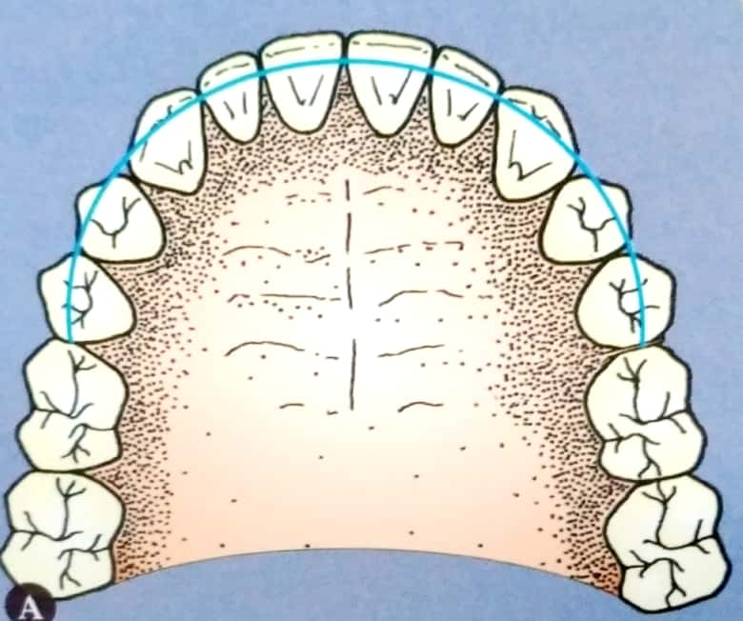
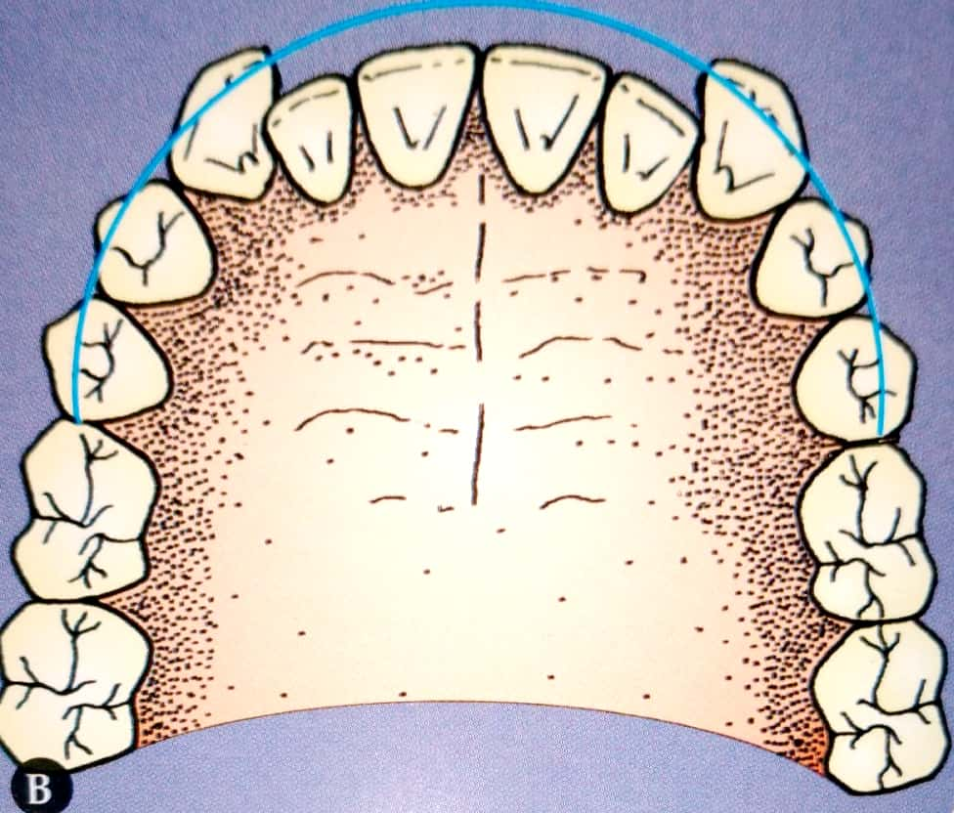
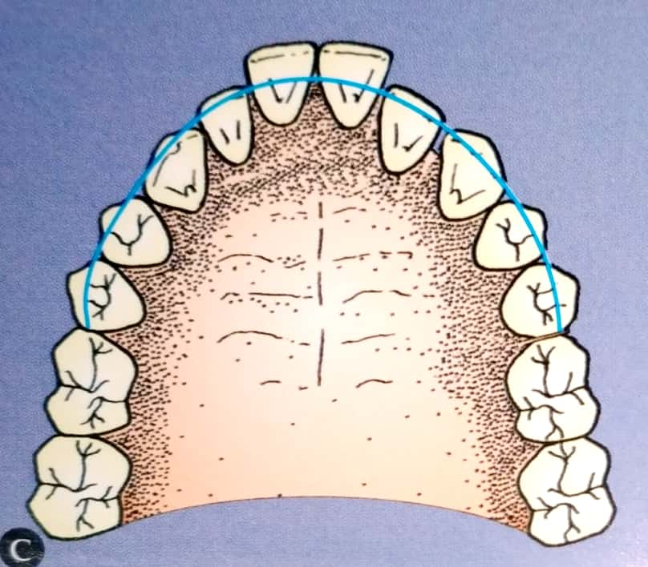
DETERMINATION OF TOOTH MATERIAL:
The mesio-distal width of the teeth anterior to the first molars is measured and summed up.
DETERMINATION OF THE DISCREPANCY:
It refers to the difference between the arch length and tooth material.

Slide 9
INFERENCE
If the discrepancy is 0 to 2.5 mm, it indicates minimal tooth material excess. In such cases, proximal stripping can be carried out to reduce the tooth material.
If the discrepancy is between 2.5 to 5 mm, it indicates the need to extract the second premolars.
A discrepancy of more than 5 mm, indicates the need to extract the first premolars.

Slide 10
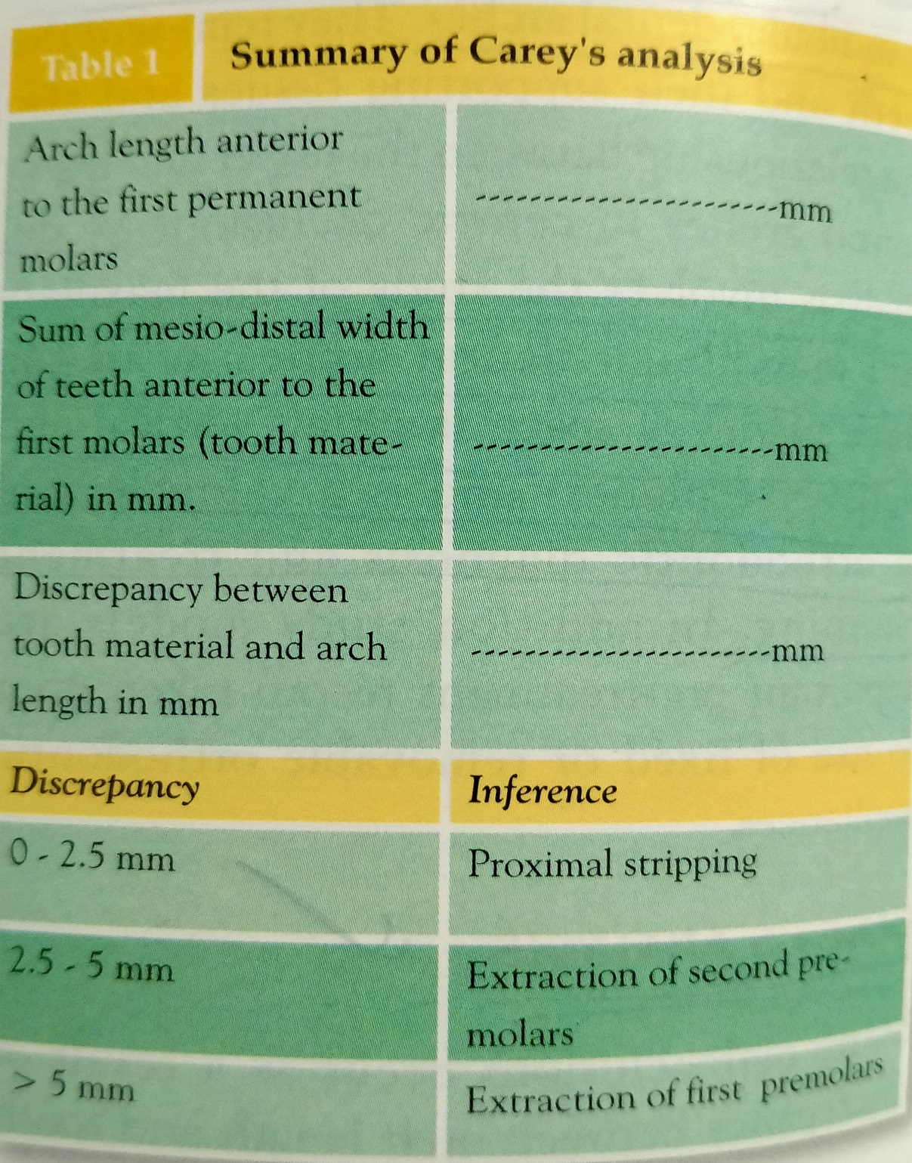

Slide 11
ARCH PERIMETER ANALYSIS
Many malocclusions occur due to discrepancy between arch length and tooth material.
It is done in the upper arch.
Arch perimeter is the geometrical dental arc formed by teeth at their incisal/ cuspal edges.

Slide 12
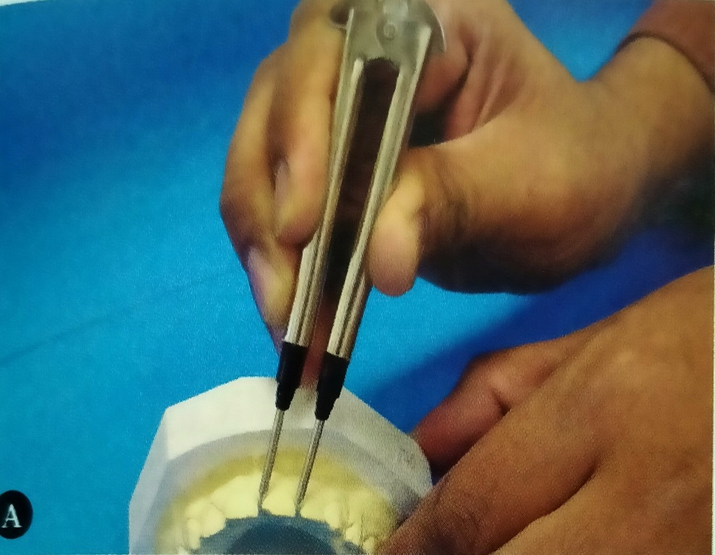
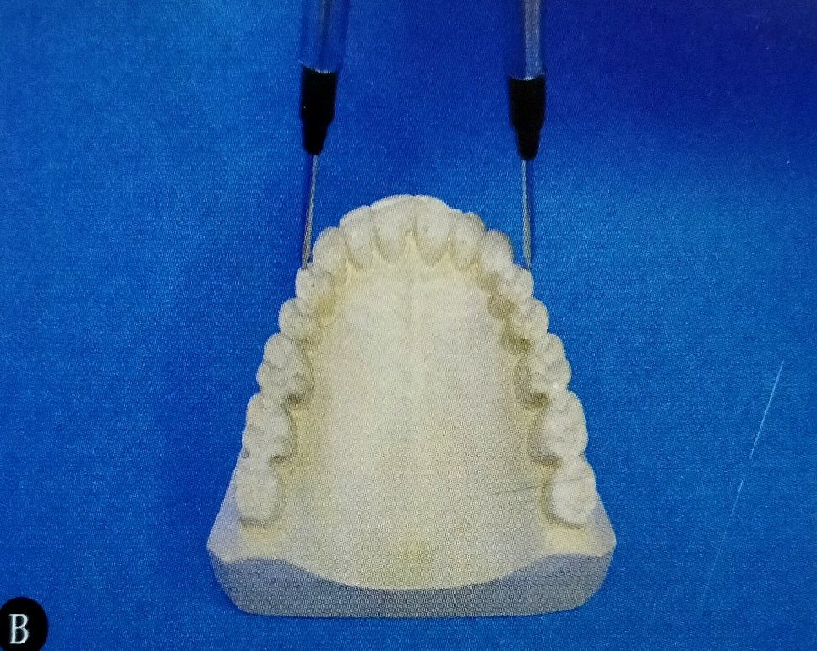
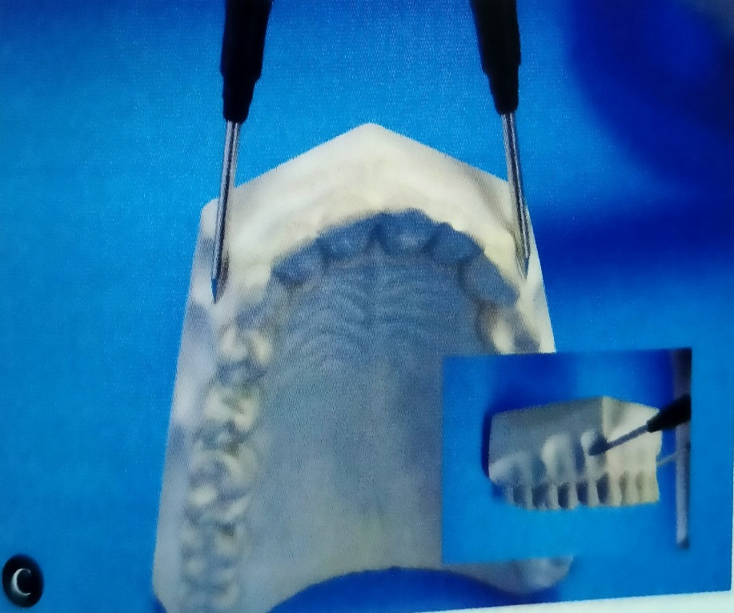
ASHLEY HOWE’S ANALYSIS
Ashley Howe considered the crowding of teeth to be the result of deficiency in arch width rather than arch length.
He found the relationship between the total width of 12 teeth anterior to the second molars and width of the dental arch in the first premolar region.
It is usually done in the upper arch

Slide 13
PROCEDURE
DETERMINATION OF TOTAL TOOTH MATERIAL (T.T.M) :
The mesio-distal width of all the teeth mesial to the second permanent molars is measured with the help of dividers and all the values are summed up. This value is called total tooth material.
DETERMINATION OF PREMOLAR DIAMETER (P.M.D) :
It refers to the arch width from the tip of the buccal cusp of one first premolar to the tip of buccal cusp of the opposite first premolar.
DETERMINATION OF PREMOLAR BASAL ARCH WIDTH (P.M.B.A.W):
The measurement of the width from canine fossa of one side to the other gives us the width of the dental arch at the apical base or the junction between the basal bone and alveolar process.

Slide 14
inference
The P.M.B.A.W and the P.M.D are compared .
If the P.M.B.A.W is greater than the P.M.D then it is an indication that the arch expansion is possible.
If on the other hand the P.M.B.A.W is less than P.M.D , then arch expansion is not possible.
It is determined using the formula:
P.M.B.A.W % = P.M.B.A.W x 100
T.T.M
If P.M.B.A.W.% is 37% or less, it indicates a need for extraction.
If P.M.B.A.W.% is 44% or more, the case can possibly be treated without extracting any teeth.
If P.M.B.A.W.% is 37- 44%, the case is referred to as a borderline case.

Slide 15
PONT’S ANALYSIS
Ponts in 1909presented a system whereby the measurement of the four maxillary incisors automatically established the width of the arch in the premolar and molar regions.
Ponts analysis helps in:
Determining whether the dental arch is narrow or is normal.
Determining the need for lateral arch expansion
Determining how much expansion is possible at the premolar and molar regions.

Slide 16
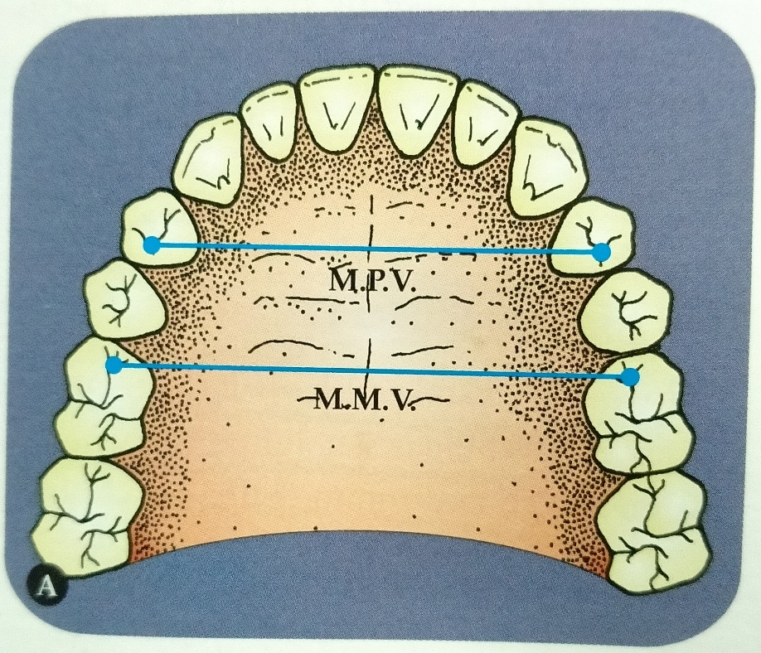
DETERMINATION OF SUM OF INCISORS (S.I.)
The mesio-distal width of the 4 maxillary incisors is measured and the values summed up. This value is called sum of incisors (S.I.)
DETERMINATION OF MEASURED PREMOLAR VALUE(M.P.V.)
The width of the arch in the premolar region from
the distal pit of one upper first premolar to the
distal pit of the opposite first premolar is measured.
It is called the measured premolar value.

Slide 17
DETERMINATION OF MEASURED MOLAR VALUE(M.M.V.)
The width of the arch in the molar region from the mesial pit of one upper first molar to the mesial pit of the opposite first molar is measured.
This value is called the measured molar value.
DETERMINATION OF CALCULATED PREMOLAR VALUE
(C.P.V)
Calculated premolar value or the expected arch width in the premolar region is determined by the formula :
S.I. x 100/80

Slide 18
DETERMINATION OF CALCULATED MOLAR VALUE (C.M.V.)
Calculated molar value or the expected arch width in the molar region is determined by the formula:
S.I. x 100/64
INFERENCE
If measured value is less than calculated value, it indicates the need for expansion.
It is possible to determine how much expansion is needed in the molar and premolar region.

Slide 19
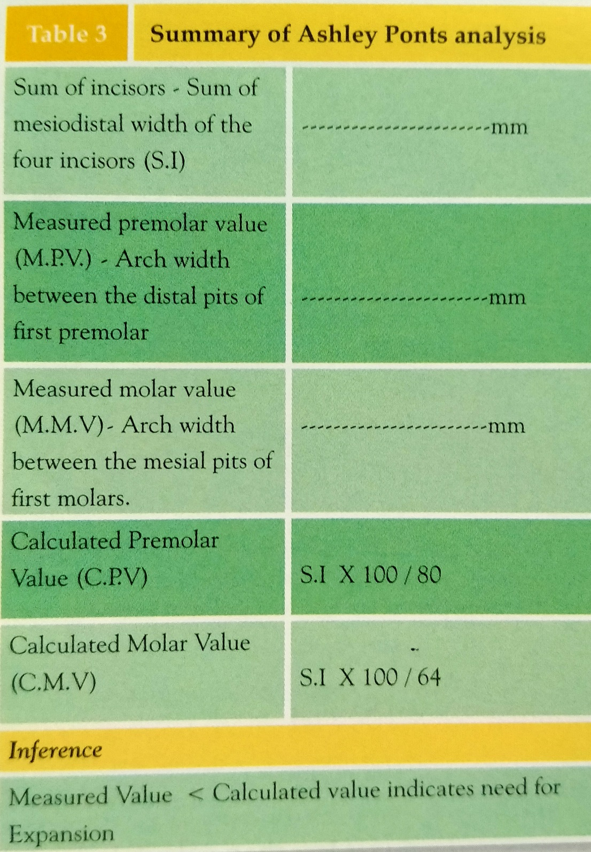

Slide 20
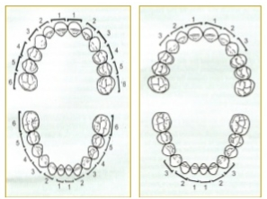
BOLTON’S ANALYSIS
According to Bolton, there exist a ratio between the mesio-distal width of the maxillary and mandibular teeth.
It helps in determining the disproportion in size between maxilla and mandibular teeth.
MEASUREMENTS
Sum of maxillary 12
Sum of mandibular 12
Sum of maxillary 6
Sum of mandibular 6
Overall ratio
Anterior ratio

Slide 21
DETERMINATION OF OVERALL RATIO:
Overall ratio = sum of mandibular 12 x 100
sum of maxillary 12
If overall ratio is less than 91.3 %, it indicates maxillary tooth material excess.
The amount of maxillary tooth material excess is determined by using the formula:
Maxillary 12- mandibular 12 x 100
91.3
If overall ratio is more than 91.3 %, it indicates mandibular tooth material excess.
The amount of mandibular excess can be determined by the formula:
Mandibular 12 - maxillary 12 x 91.3
100

Slide 22
DETERMINATION OF ANTERIOR RATIO:
Anterior ratio = sum of mandibular 6 x 100
sum of maxillary 6
If the anterior ratio is less than 77.2% it indicates maxillary anterior excess.
The amount of maxillary anterior excess is determined by :
Maxillary 6 – mandibular 6 x 100
77.2
If the anterior ratio is more than 77.2%, it indicates mandibular anterior excess.
If the amount of mandibular anterior excess is determined by:
Mandibular 6 – maxillary 6 x 77.2
100

Slide 24
MIXED DENTITION ANALYSIS
The purpose of a mixed dentition analysis is to evaluate the amount of space available in the arch for the erupting permanent canines and premolars.
The aim is to compare the space available for the unerupted permanent canine and premolars with the space needed, the difference gives us the amount of crowding or spacing that can be expected.

Slide 25
Moyer’s mixed dentition analysis
The Moyer’s mixed dentition analysis predicts the combined mesio-distal width of 3,4 and 5 based on the sum of the widths of the four lower permanent incisors.
The amount of space available for 3,4 and 5 after incisor alignment is determined by measuring the distance between the distal surface of lateral incisor and the mesial surface of first permanent molar.
The predicted tooth size of 3,4 and 5 is compared with the arch length available for them so as to determine the discrepancy.
If the predicted value is greater than the available arch length, crowding of teeth can be expected.

Slide 26
RADIOGRAPHIC METHOD
This technique makes use of a radiograph as well as a study cast to determine the width of the unerupted teeth.
It is possible to determine the measurements of the unerupted teeth by studying the teeth that have already erupted in a radiograph and on a cast.
The formula is :
Y1= X1 x Y2
X2
Y1= width of unerupted tooth whose measurement is to be determined.
Y2= width of unerupted tooth on radiograph.
X1= width of tooth that has erupted, measured on the cast.
X2= width of tooth that has erupted, measured on the radiograph.

Slide 27
Tanaka Johnston method
This is a non radiographic method of mixed dentition analysis suggested by Tanaka and Johnston in 1974.
This method uses the width of lower incisors to predict the width of unerupted canines and premolars of the upper and lower arches.
They have simplified Moyer’s 75% prediction table into a formula:
The predicted width of maxillary canine and premolars =
Sum of mandibular incisors + 11
2
The predicted width of the mandibular canine and premolars =
Sum of mandibular incisors + 10.5
2

Slide 28
CONCLUSION
Model analysis forms an integral aspect of orthodontic diagnosis determine whether the treatment plan is going to involve serial extraction, space maintainance, space gaining or simply periodic observation of the patient.

Slide 29
REFERENCES
Textbook of Orthodontics – Gurkeerat Singh, Jaypee Brothers; 2nd Edition
Orthodontics – The Art and Science, S.I Bhalajhi, AryaMedi Publishing; 7th Edition
Textbook of Orthodontics – Sridhar Premkumar, Elsevier; 1st Edition
Orthodontics: Diagnosis and Management of Malocclusion and Dentofacial Deformities – O.P Kharbanda, Elsevier; 1st Edition

Slide 30
Question & Answer Session

